Slide 1





DATA-DRIVEN INSIGHTS FOR A NEW MOVIE STUDIO
PRESENTED BY: Leslie Nungi
LINKEDIN: www.linkedin.com/in/leslie-nungi-17499627b
Presentation

Slide 2

Introduction
Our company want to launch a new movie studio but does not know what kind of movies will succeed.
We need data-driven insights to guide decisions about what types of movies to produce.

Slide 3

Project Goal
The goal was to find what movies made the most money globally.
I asked myself three key questions:
Which genres earned the most?
What is the most ideal runtime for a movie?
Which release decade are most profitable?

Slide 4
Data sources
IMDB:
Contains movie details(titles, genres, runtime and release year)
Box office
Mojo:
Contains domestic and international gross data.
I then combined the data for more and complete insights into performance and content.

Slide 5

q
Methods Used
Used python and SQL to extract, clean, and combine movie data.
Performed exploratory data analysis(EDA) to uncover patterns.
Created clear visuals to help understand trends.

Slide 6
Findings

Slide 7

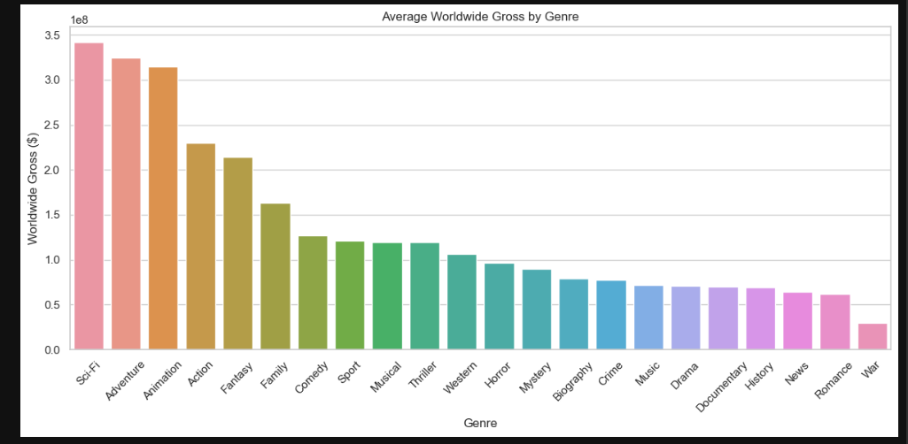
Bar chart of Average Worldwide Gross by Genre
Top earning Genres
Insight: Sci-fi, adventure and animation earn the most globally
Recommendation: Focus on this genres to maximize profits

Slide 8
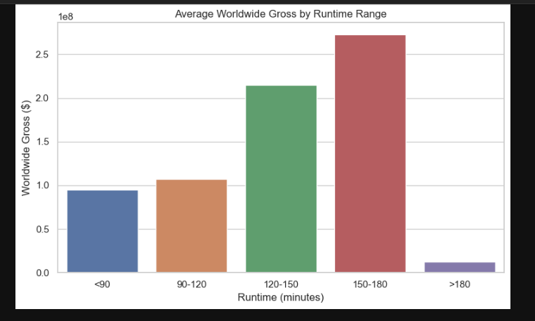
Runtime Performance
Insight: Movies between 120–150 minutes perform best.
Recommendation: Aim for this runtime range for best profitability.

Slide 9

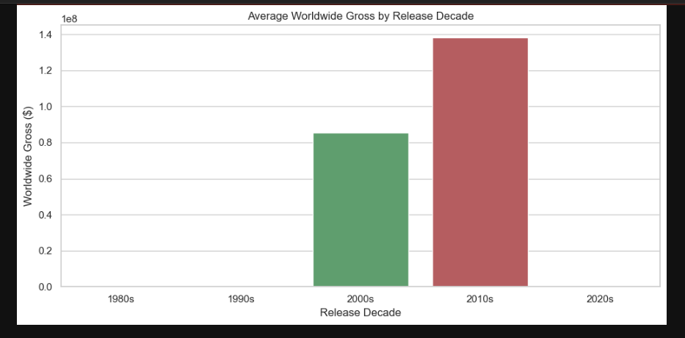
Bar chart of Release Decade vs Gross
Release Date Impact
Insight: Films from the 2010s and 2020s have higher global earnings.
Recommendation: Focus on modern themes and recent trends when producing films.

Slide 10

Next Steps
Share findings with content development and production teams.
Use results to inform pilot projects or early investments.
Explore adding streaming performance data in future phases.

Slide 11

Thank You!
Thank you for your time
I happy to answer any question.
You can contact me on : www.linkedin.com/in/leslie-nungi-17499627b

